Slide 1


Slide 2

Rabbinic Style Of Teaching And Rebuking
To quote a part of scripture, leaving the ending for the audience to know.

Slide 3
Rabbinic Style Of Teaching And Rebuking
Jesus speaking in Matt 21:16
“From the lips of children and infants you have ordained praise”

Slide 4
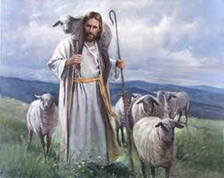
JOHN
10:14-15
THE SHEPHERD KNOWS HIS SHEEP
JESUS SAYS “I AM” THE GOOD SHEPHERD
THE SHEPHERD OF PSALM 23

Slide 5
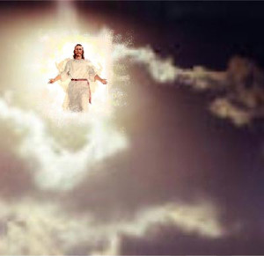
DANIEL
7:13-14
THE SON OF MAN
80 PLUS TIMES IN THE GOSPELS
THE HUMANITY OF GOD ON EARTH

Slide 6

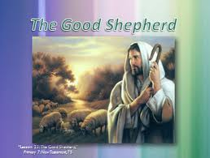
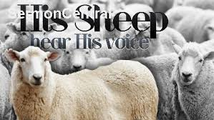
JESUS TAUGHT BY QUOTING O.T. SCRIPTURE
JESUS SAID HE WAS THE GOOD SHEHERD
JESUS SAID HE WAS THE SON OF MAN
JESUS SAID HE IS GOD!

Slide 7
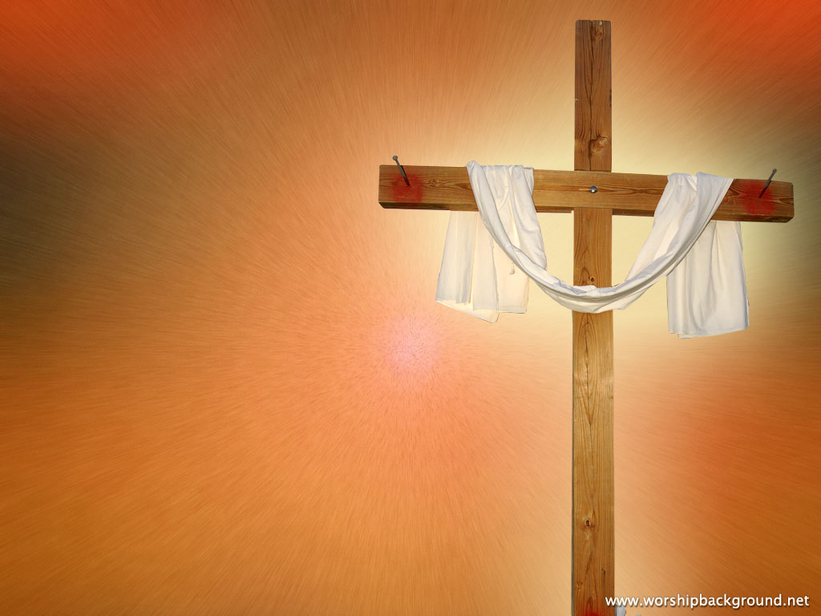
HEAR GOD’S WORD
BELIEVE IN JESUS
CONFESS HIM AS YOUR SAVIOR
REPENT OR YOUR SINS
BE BAPTIZED IN CHRIST
LIVE YOUR LIFE FOR AND WITH CHRIST

